Slide 1
IP Addressing & Subnetting
IP Addressing
Subnetting
VLSM
CIDR

Slide 2
IP Addresses
An IP address is an address used to uniquely identify a device on an IP network.
The address is made up of 32 binary bits which can be divisible into a network portion and host portion with the help of a subnet mask.
32 binary bits are broken into four octets (1 octet = 8 bits)
Dotted decimal format (for example, 172.16.81.100)

Slide 3
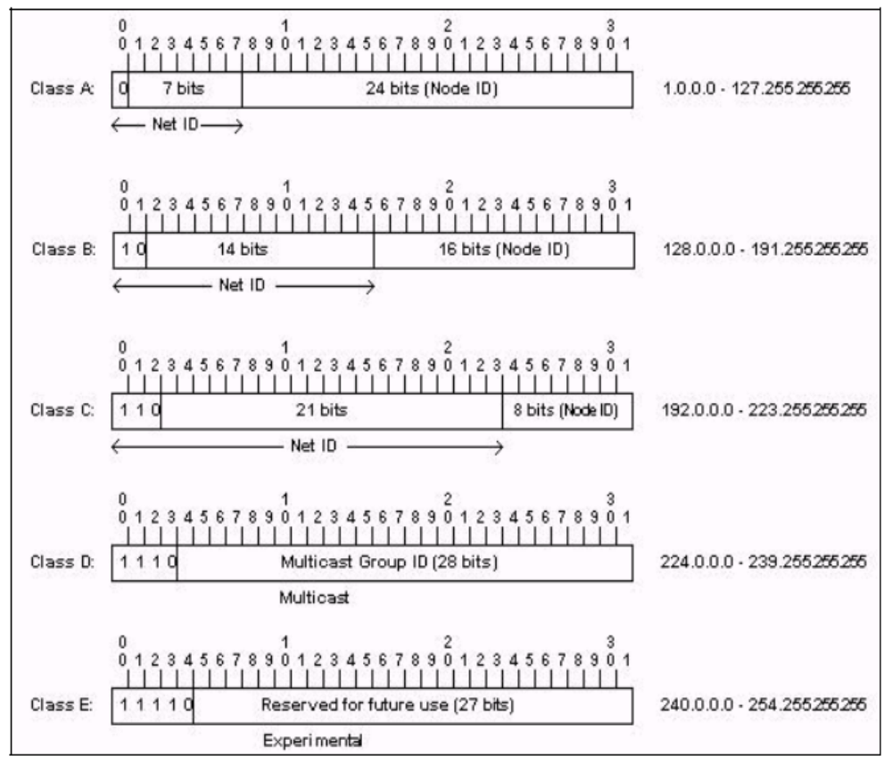
IP Address Classes

Slide 4
IP Address Classes
Class A: The first octet is the network portion. Octets 2, 3, and 4 are for subnets/hosts
Class B: The first two octets are the network portion. Octets 3 and 4 are for subnets/hosts
Class C: The first three octets are the network portion. Octet 4 is for subnets/hosts

Slide 5
Private Address Range
Address Class | Reserved Address Space
Class A | 10.0.0.0 - 10.255.255.255
Class B | 172.16.0.0 - 172.31.255.255
Class C | 192.168.0.0 - 192.168.255.255

Slide 6
Network Masks
Distinguishes which portion of the address identifies the network and which portion of the address identifies the node.
Default masks:
  Class A: 255.0.0.0
  Class B: 255.255.0.0
  Class C: 255.255.255.0

Slide 7
Subnetting
Creates multiple logical networks that exist within a single Class A, B, or C network.
If you do not subnet, you will only be able to use one network from your Class A, B, or C network, which is unrealistic
Each data link on a network must have a unique network ID, with every node on that link being a member of the same network

Slide 8
Benefits of Subnetting
Reduced network traffic
Optimized network performance
Simplified management
Facilitated spanning of large geographical distances

Slide 9
IP Subnet-Zero
This command allows you to use the first and last subnet in your network design.
For example, the Class C mask of 192 provides subnets 64 and 128, but with the IP subnet-zero command, you now get to use subnets 0, 64, 128, and 192

Slide 10
How to create subnets
Determine the number of required network IDs:
  One for each subnet
  One for each wide area network connection
Determine the number of required host IDs per subnet:
  One for each TCP/IP host
  One for each router interface
Based on the above requirements, create the following:
  One subnet mask for your entire network
  A unique subnet ID for each physical segment
  A range of host IDs for each subnet

Slide 11
Subnetting a Class A/B/C Address
How many subnets does the chosen subnet mask produce?
How many valid hosts per subnet are available?
What are the valid subnets?
What’s the broadcast address of each subnet?
What are the valid hosts in each subnet?

Slide 12
Practice Example #1C: 255.255.255.128 (/25)
Network 192.168.10.0
How many subnets? Since 128 is 1 bit on (10000000), the answer would be 2¹= 2.
How many hosts per subnet? We have 7 host bits off (10000000), so the equation would be 2⁷– 2 = 126 hosts.
What are the valid subnets? 256 – 128 = 128. Remember, we’ll start at zero and count in our block size, so our subnets are 0, 128.
What’s the broadcast address for each subnet? The number right before the value of the next subnet is all host bits turned on and equals the broadcast address. For the zero subnet, the next subnet is 128, so the broadcast of the 0 subnet is 127.
What are the valid hosts? These are the numbers between the subnet and broadcast address

Slide 13
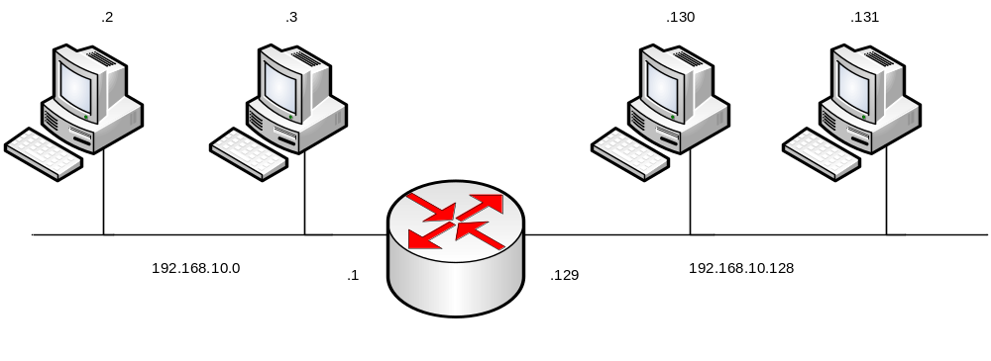
Logical Network Implementation

Slide 14
Practice Example #2C: 255.255.255.224 (/27)
Network 192.168.10.0
How many subnets? 224 is 11100000, so our equation would be 2³ = 8.
How many hosts? 2⁵– 2 = 30.
What are the valid subnets? 256 – 224 = 32. We just start at zero and count to the subnet mask value in blocks (increments) of 32: 0, 32, 64, 96, 128, 160, 192, and 224.
What’s the broadcast address for each subnet (always the number right before the next subnet)?
What are the valid hosts (the numbers between the subnet number and the broadcast address)?

Slide 15
Practice Example #2C: 255.255.255.224 (/27)
Network 192.168.10.0
Subnet Address | 0 | 32 | …………. | 192 | 224
First Host | 1 | 33 |  | 193 | 225
Last Host | 30 | 62 |  | 222 | 254
Broadcast Address | 31 | 63 |  | 223 | 255

Slide 16
Practice Example #1B: 255.255.128.0 (/17)
Network 172.16.0.0
Subnets? 2¹ = 2
Hosts? 2¹⁵– 2 = 32,766 (7 bits in the third octet, and 8 in the fourth)
Valid subnets? 256 – 128 = 128. 0, 128. Remember that subnetting is performed in the third octet, so the subnet numbers are really 0.0 and 128.0, as shown in the next table
Broadcast address for each subnet?
Valid hosts?

Slide 17
Practice Example #1B: 255.255.128.0 (/17)
Network 172.16.0.0
Subnet | 0.0 | 128.0
First Host | 0.1 | 128.1
Last Host | 127.254 | 255.254
Broadcast | 127.255 | 255.255

Slide 18
Practice Example #2B: 255.255.240.0 (/20)
Network 172.16.0.0
Subnets? 2⁴= 16.
Hosts? 2¹² – 2 = 4094.
Valid subnets? 256 – 240 = 0, 16, 32, 48, etc., up to 240.
Broadcast address for each subnet?
Valid hosts?

Slide 19
Practice Example #2B: 255.255.240.0 (/20)
Network 172.16.0.0
Subnet | 0.0 | 16.0 | ……….. | 240.0
First Host | 0.1 | 16.1 |  | 240.1
Last Host | 15.254 | 31.254 |  | 255.254
Broadcast | 15.255 | 31.255 |  | 255.255

Slide 20
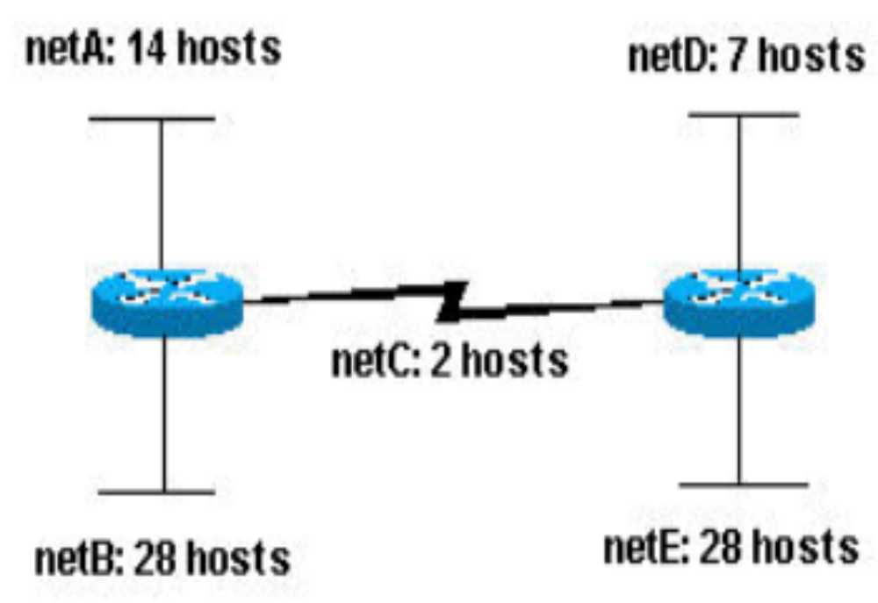
Variable Length Subnet Mask(VLSM)
Subnet with requirements shown?

Slide 21
Variable Length Subnet Mask(VLSM)
Subnet with requirements shown?
5 subnets needed
Can be assigned as follows:
  netA: 204.15.5.0/27 host address range 1 to 30
  netB: 204.15.5.32/27 host address range 33 to 62
  netC: 204.15.5.64/27 host address range 65 to 94
  netD: 204.15.5.96/27 host address range 97 to 126
  netE: 204.15.5.128/27 host address range 129 to 158

Slide 22
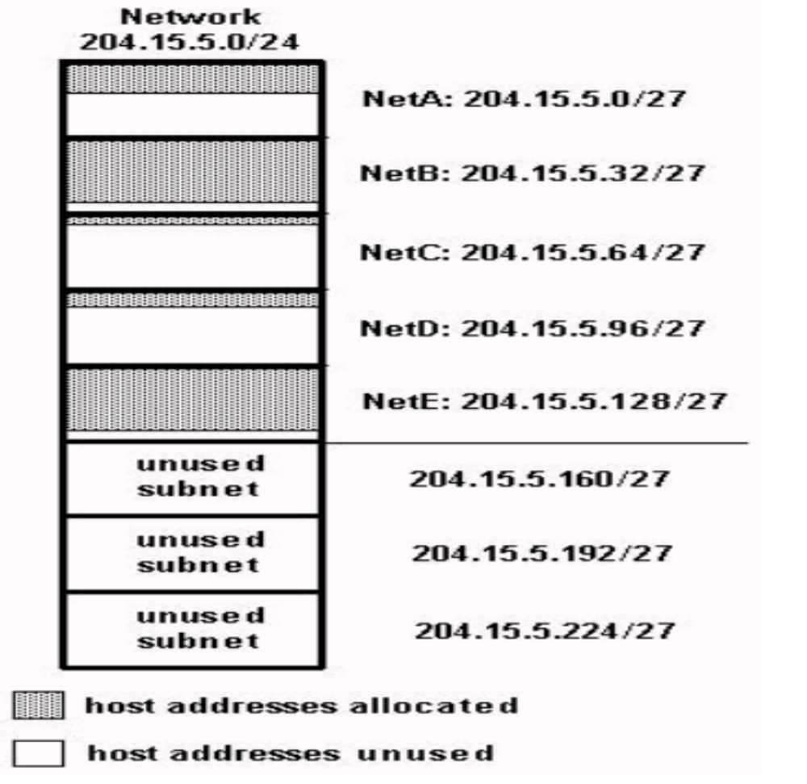
Variable Length Subnet Mask(VLSM)
Subnet with requirements shown?

Slide 23
Variable Length Subnet Mask(VLSM)
Subnet with requirements shown?
Given the same network and requirements as in Sample Exercise 1 develop a subnetting scheme using VLSM, given:
  netA: must support 14 hosts
  netB: must support 28 hosts
  netC: must support 2 hosts
  netD: must support 7 hosts
  netE: must support 28 host
Determine what mask allows the required number of hosts.
  netA: requires a /28 (255.255.255.240) mask to support 14 hosts
  netB: requires a /27 (255.255.255.224) mask to support 28 hosts
  netC: requires a /30 (255.255.255.252) mask to support 2 hosts
  netD: requires a /28 (255.255.255.240) mask to support 7 hosts
  netE: requires a /27 (255.255.255.224) mask to support 28 hosts

Slide 24
Variable Length Subnet Mask(VLSM)
Subnet with requirements shown?
The easiest way to assign the subnets is to assign the largest first. For example, you can assign in this manner:
  netB: 204.15.5.0/27 host address range 1 to 30
  netE: 204.15.5.32/27 host address range 33 to 62
  netA: 204.15.5.64/28 host address range 65 to 78
  netD: 204.15.5.80/28 host address range 81 to 94
  netC: 204.15.5.96/30 host address range 97 to 98

Slide 25
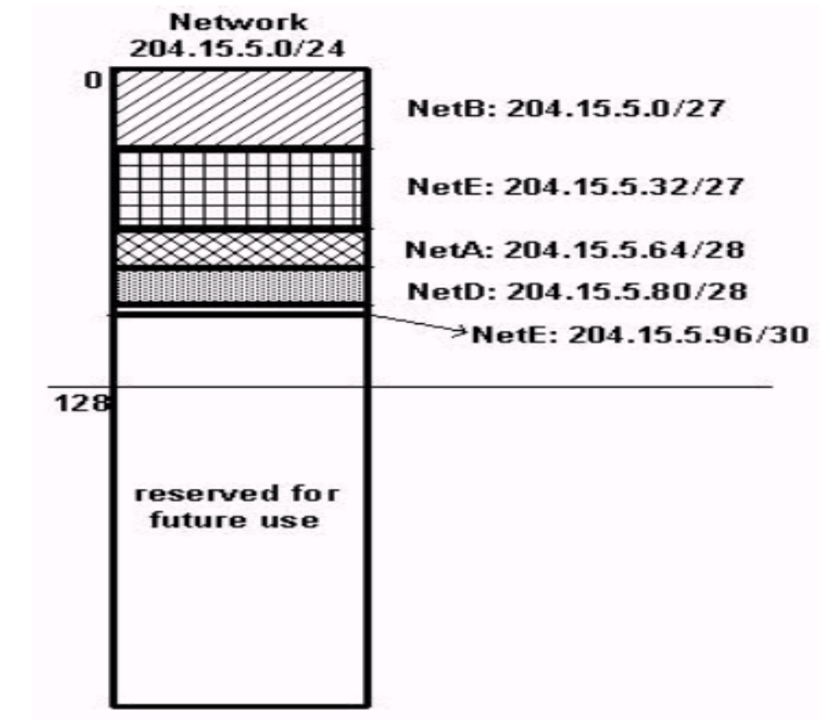
Variable Length Subnet Mask(VLSM)
Subnet with requirements shown?

Slide 26
CIDR
Classless Interdomain Routing
Improve address space utilization
Routing scalability in the Internet
For example, if an ISP owns network 172.16.0.0/16, then the ISP can offer 172.16.1.0/24, 172.16.2.0/24,and so on to customers. Yet, when advertising to other providers, the ISP only needs to advertise 172.16.0.0/16

